Slide 1
Python intro

Slide 2

PLAN
Intro. Python Core
Definition
Data
Syntax crash course

Slide 3

Definition
Python is an interpreted, high-level and general-purpose programming language. Python's design philosophy emphasizes code readability with its notable use of significant whitespace. Its language constructs and object-oriented approach aim to help programmers write clear, logical code for small and large-scale projects.
Python is developed by Guido van Rossum
First version was delivered in 1991

Slide 4
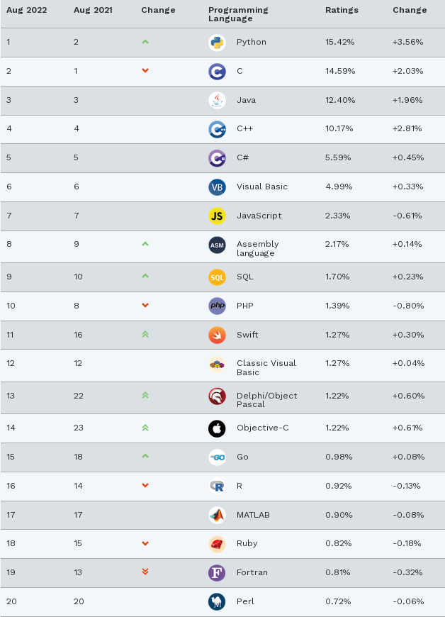
Rating Table
TIOBE Index for August 2022
The TIOBE Programming Community index is an indicator of the popularity of programming languages. The index is updated once a month. The ratings are based on the number of skilled engineers world-wide, courses and third party vendors. Popular search engines such as Google, Bing, Yahoo!, Wikipedia, Amazon, YouTube and Baidu are used to calculate the ratings.

Slide 5
AGENDA
Why people use Python? Where can I use Python?
System programming (files, sockets, process, threads, re, command-line arguments, shell-command launchers, CSV, XML, JSON, etc.)
GUI (Tkinter, Qt, Kivy, etc.)
Web (Django, Flask, web2py, etc.)
Component Integration (SWIG for C-like code, Jython for Java, IronPython for C#)
Database Programming (SQLAlchemy, all modern databases)
Testing (pytest + requests)
And many more...
Software Quality (readability, easy to understand)
Developer productivity (smaller codebase, without lengthy compile)
Portability (all major computer platforms)
Support libraries (standard library + third-party domain)

Slide 6
Assignment
a
1
b
2
a, b
3, 4

Slide 7
Data TYPES
DATA TYPE
MUTABLE
IMMUTABLE
LIST
Set
Frozen Set
String
Numbers
Tuple
Boolean
None
DICTIONARY
INT
NAMED TUPLE
FLOAT
COMPLEX NUMBERS

Slide 8
integers
Python includes three numeric types to represent numbers: integers, float, and complex number:
Operator | Description | Example
+ (Addition) | Adds operands on either side of the operator. | >>> a=10; b=20 >>> a+b 30
- (Subtraction) | Subtracts the right-hand operand from the left-hand operand. | >>> a=10; b=20 >>> b-a 10 >>> a-b -10
* (Multiplication) | Multiplies values on either side of the operator. | >>> a=10; b=20 >>> a*b 200
/ (Division) | Divides the left-hand operand by the right-hand operand. | >>> a=10; b=20 >>> b/a 2
% (Modulus) | Returns the remainder of the division of the left-hand operand by right-hand operand. | >>> a=10; b=22 >>> b%a 2
** (Exponent) | Calculates the value of the left-operand raised to the right-operand. | >>> a=3 >>> a**2 9 >>> a**3 27
// (Floor Division) | The division of operands where the result is the quotient in which the digits after the decimal point are removed. But if one of the operands is negative, the result is floored, i.e., rounded away from zero (towards negative infinity): | >>> a=9; b=2 >>> a//b 4

Slide 9
STRING
string = “Some string”
big_string = """ a very
very much bigger
than normal one """
print("python" == 'python')
output
True
problem = 'C:\teeeeeeext.txt’
no_problem = r'C:\teeeeeeext.txt’
no_problem_2 = 'C:\\teeeeeeext.txt’
print(problem, no_problem, no_problem_2, sep='\n')
C: eeeeeeext.txt
C:\teeeeeeext.txt
C:\teeeeeeext.txt
output

Slide 10
lists
some_list1 = [1, 2, 3]
some_list2 = [‘one’, ’two’, ’three’]
0
1
2
some_list2.append(1)
output
[‘one’, ’two’, ’three’, 1]
some_list2.insert(1, “sword”)
output
[‘one’, ’sword’, ’two’, ’three’, 1]
some_list2.reverse()
output
[1, ‘three’, ‘two’, ‘sword’, ‘one’]

Slide 11
dictionaries
key
value
key
value
key
value
some_dict = {“first”: 1, ”second”: 2, “third”: 3}
some_dict.get(“first”)
1
output
some_dict.pop(“first”)
output
{”second”: 2, “third”: 3}
some_dict.clear()
output
{}
some_dict.keys()
output
([“first”, ”second”, “third”])

Slide 12
SET
some_set = {“apple”, ”banana”, ”cherry”}
some_set.add("orange")
output
{“apple”, ”banana”, ”cherry”, “orange‘’}
some_set.clear()
output
{}
x = {"apple", "banana", "cherry"} y = {"google", "microsoft", "apple"} z = x.difference(y)
output
{'cherry', 'banana'}

Slide 13

Syntax crash course
print("Hello world!")
Hello world!

Slide 14
Function calls
import math
The import keyword is used to import modules
Name of module
math.pow(2, 3)
8.0
output
10

Slide 15
if/elif/else
case = 1
statement
condition
variable
Equality operator
if case == 1:
print("1")
elif case == 2:
print("2")
else:
print("Other")
1
output

Slide 16
For iteration
for i in range(1, 3):
print(i, end=" ")
output
1 2

Slide 17
While Loop
a, b = 1, 3
while b > a:
print("Hello")
a += 1
else:
print("Finish")
while 3 > 1:
print("Hello")
1 += 1
else:
print("Finish")
3>1
output
Hello
while 3 > 2:
print("Hello")
2 += 1
else:
print("Finish")
3>2
output
Hello
while 3 > 3:
print("Hello")
2 += 1
else:
print("Finish")
3>3
output
Finish

Slide 18
Break, continue
a = 0
while True:
0 += 1
if 1 % 2 == 0:
continue
if 1 > 3:
break
print(a)
a = 0
while True:
1 += 1
if 2 % 2 == 0:
continue
if 2 > 3:
break
print(a)
a = 0
while True:
a += 1
if a % 2 == 0:
continue
if a > 3:
break
print(a)
a = 0
while True:
2 += 1
if 3 % 2 == 0:
continue
if 3 > 3:
break
print(a)
output
1
3

Slide 19
Function definition, return, pass placeholder
Function keyword
Name of function
def myfunc():
pass
Body of function

Slide 20
Class
Class keyword
Name of the class
class Person:
pass
a = A()
print(a)

Slide 21
Exceptions (try/except/finally, raise)
try:
raise ValueError("message")
except Exception as e:
print(e)
finally:
print("I am a final block!")
message
I am a final block!
output

Slide 22
Context manager
with open("text.txt") as f:
print(f.read())
output
I am a file with some text!

Slide 23
Thank YOU!

